Slide 1
Chalkboard
Presented by: Chengshui Zhu, Giorgio Wirawan, Yeongho Lee, Kareem Virani
July 8, 2024

Slide 2
What and Why?
Chalkboard a learning platform that enables users to register for class courses as well as creating their own class courses. The platform is convenient for students who wants to join certain courses and it’s also convenient for the instructors to use.
Note: Everyone can be a teacher and a learner.

Slide 3
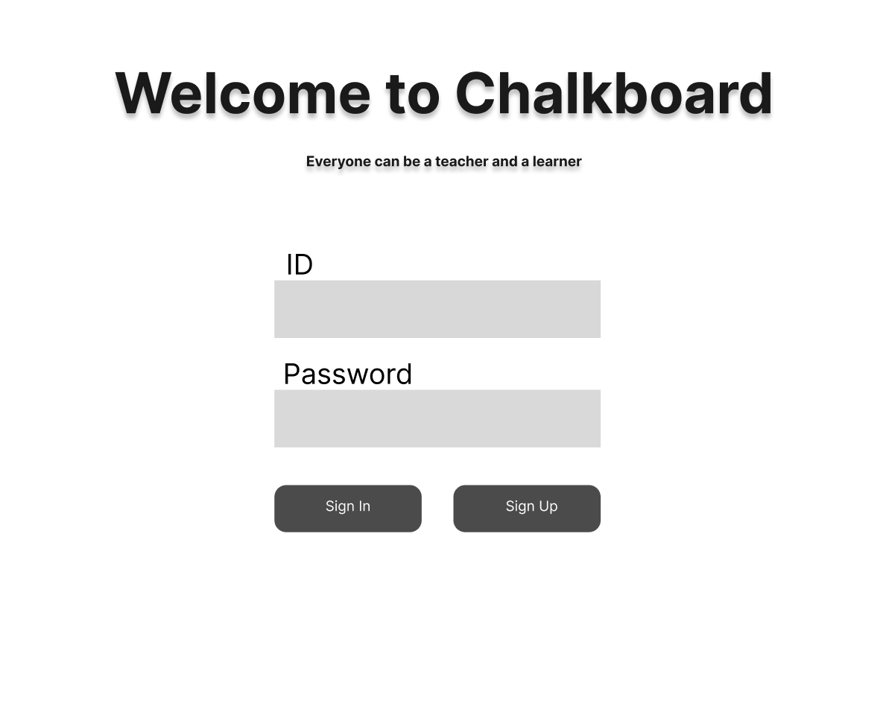
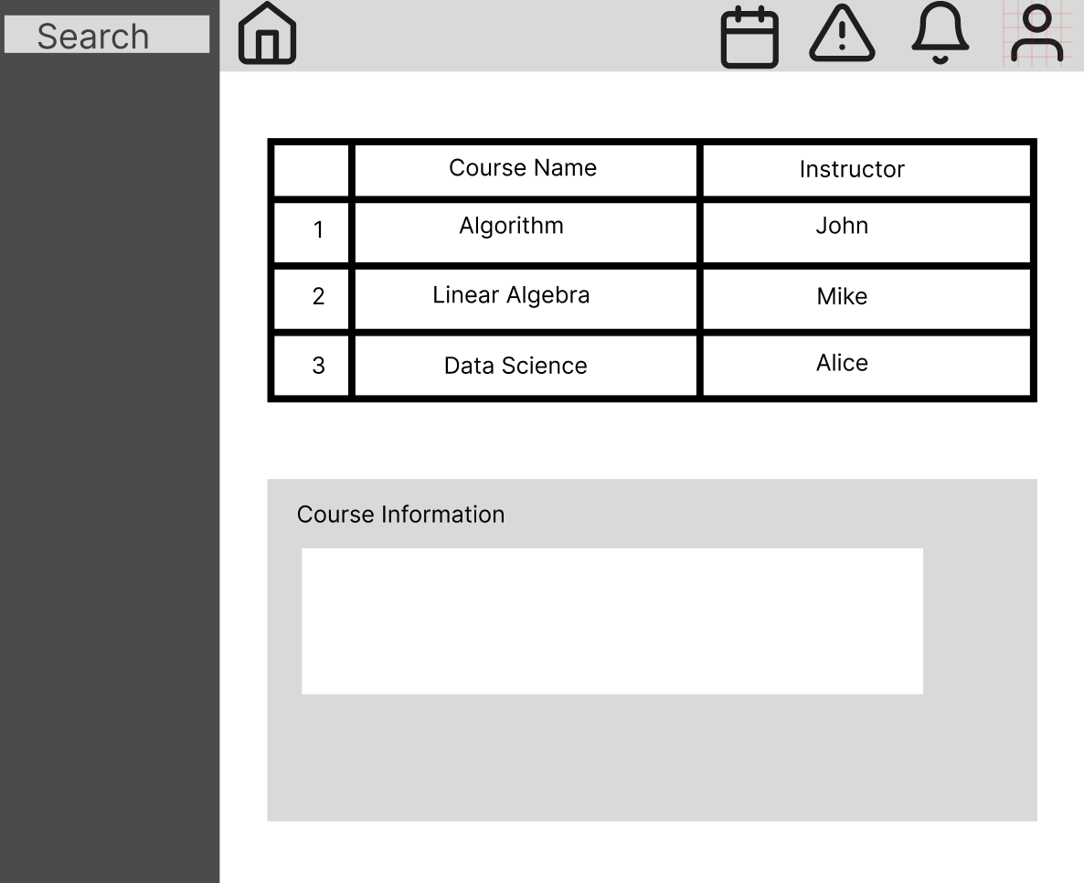
Mockup

Slide 4
Use Cases and User Journey
Use Cases
User Journey
User can sign up and login through email
Login or Sign Up
Choose which mode to be in
User can decide switch between student mode and instructor mode
Student
Instructor
User can create courses in instructor mode
Search course
Create a course
Enroll in course
Complete enrolled courses
Manage created courses
User can enroll and complete courses created by instructors in student mode
User can search courses that is available

Slide 5
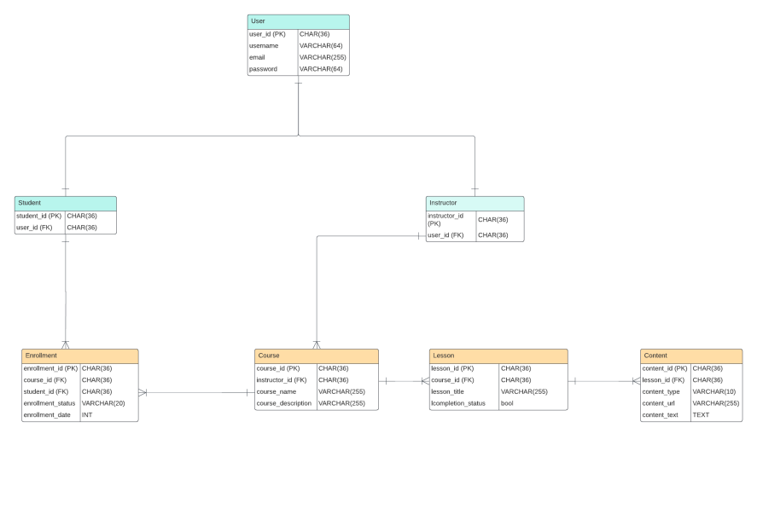
The Data

Slide 6



The Stack
Backend
Frontend
MySQL
For database

Slide 7
Team Member and our roles
Chengshui Zhu - frontend/product manager
Giorgio Wirawan - backend developer
Yeongho Lee - frontend developer
Kareem Virani - backend/code reviewer

Slide 8
Q&A
Thank you!

